Slide 1
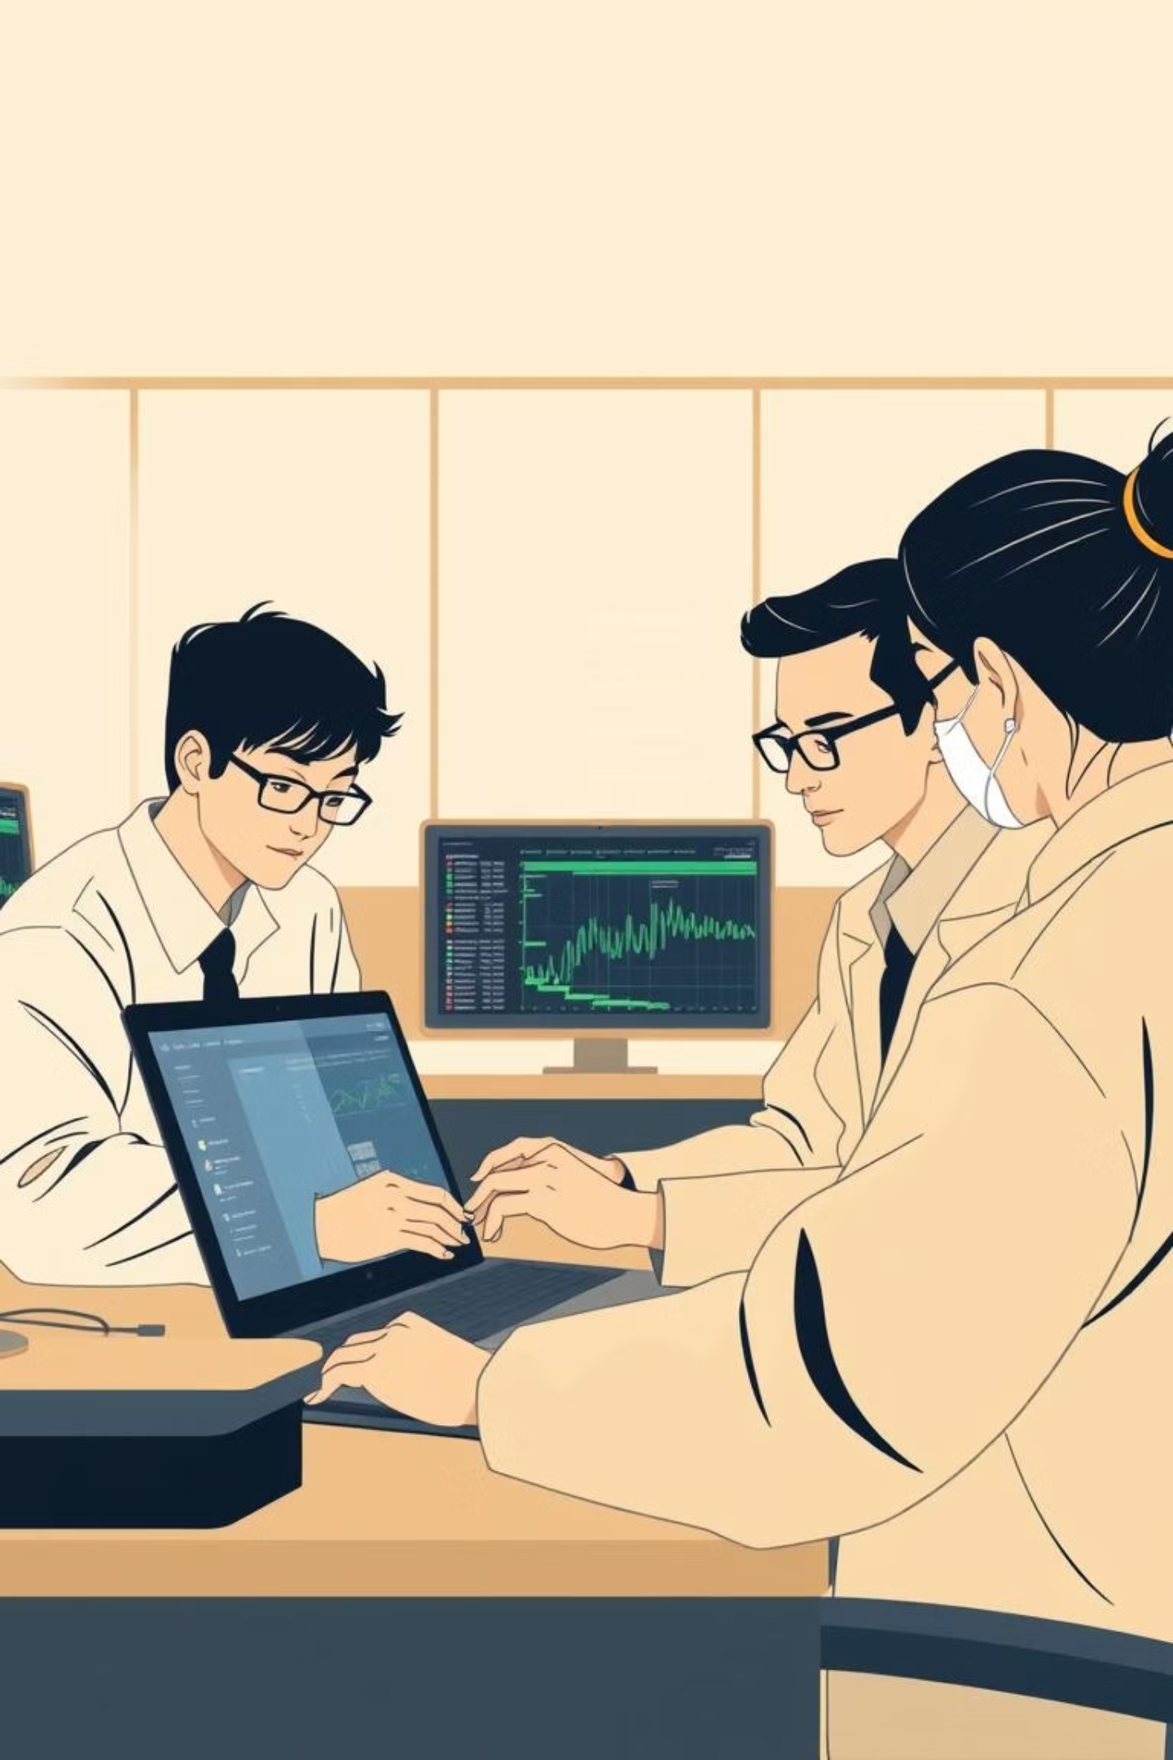
Deepfake Detector Tool
Presented by: Khushi Patel, Jyotsana, John Ademola, Vipul Bodhani

Slide 2

Functional Requirements: Must-Have Features
Our core focus for the Deepfake Detector Tool is to deliver essential functionalities that provide immediate value in identifying manipulated media.
1
2
Video File Upload
Deepfake Probability Score
Seamless ingestion of video content for analysis.
A clear, single metric indicating the likelihood of deepfake manipulation at a video level.
3
4
Explainability Overlay
Simple UI
Visual heatmaps on video frames to highlight regions of manipulation, enhancing user understanding.
An intuitive user interface for web ensuring ease of use.
5
Simple Report
Basic downloadable analysis report for users to retain results for future reference.

Slide 3


Functional Requirements: Nice-to-Have Enhancements
Beyond the core features, these additions will further bolster the tool's capabilities and user experience, planned for future iterations.
Audio-Based Detection
Real-time Alerts
Analyze speech patterns and anomalies.
Browser or meeting plugin for instant deepfake detection.
Identify manipulated audio tracks in deepfake videos.
Immediate notifications for suspicious content during live interactions.

Slide 4
Non-Functional Requirements: Pillars of Our System
These requirements ensure our Deepfake Detector Tool is not only effective but also robust, reliable, and user-friendly.
Performance
Scalability
Accuracy
Fast analysis: <60 seconds for a 20-second video clip leveraging GPU acceleration.
Support for concurrent uploads through efficient queuing and batch processing.
High precision and recall rates with a calibrated threshold for deepfake detection.
Usability
Maintainability
Clear probability scores and compelling visual evidence for easy interpretation.
A modular pipeline design allowing for easy integration and swapping of detection models.

Slide 5
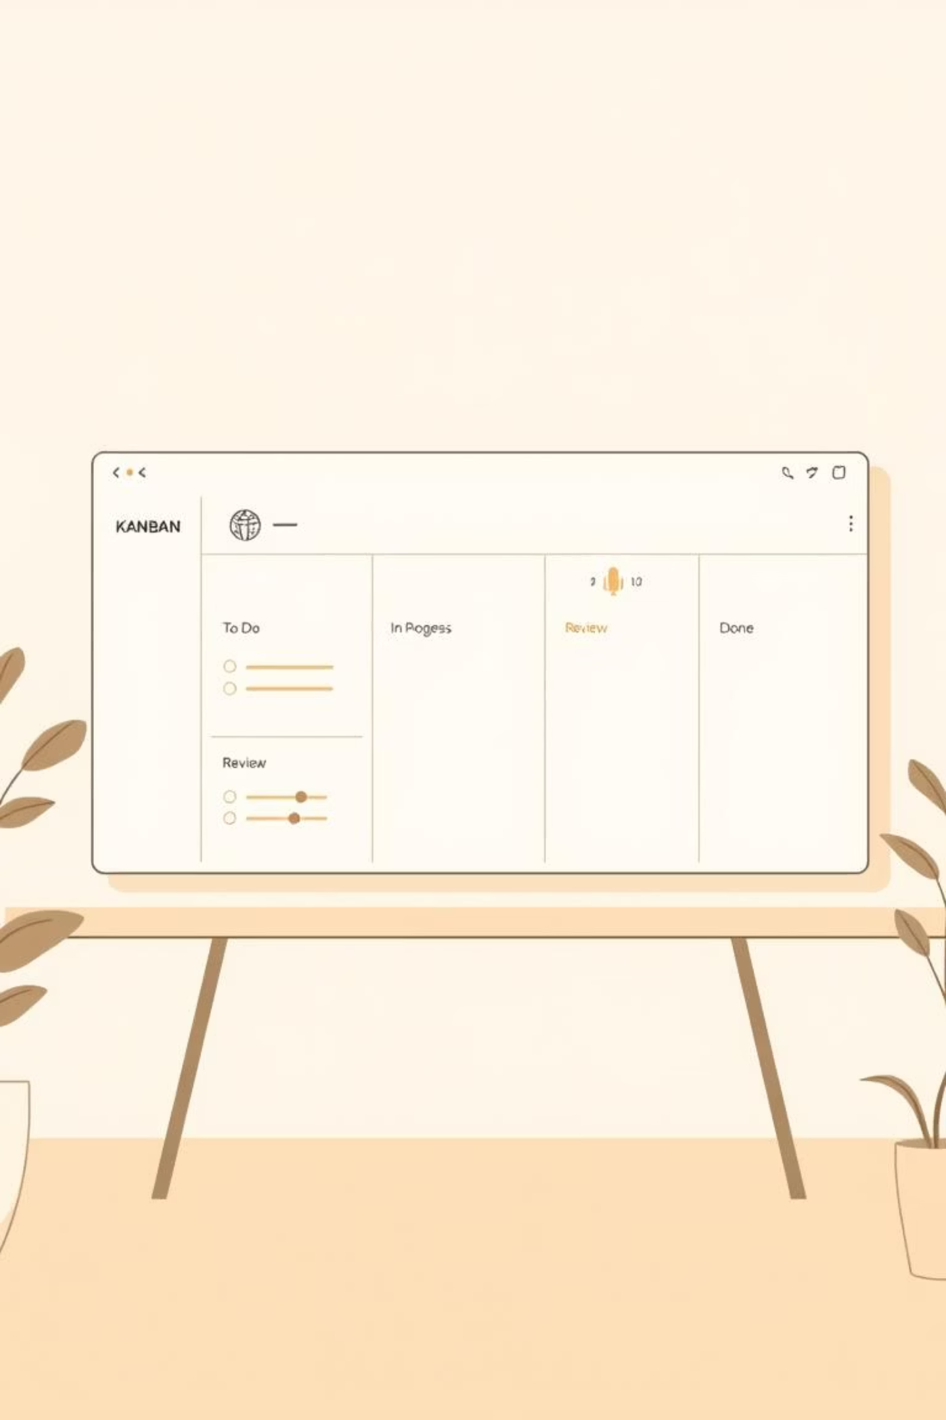
Main Tasks Before Midterm: Weeks 3–5
Our initial phase focuses on foundational setup, data acquisition, and preprocessing to prepare for model development.
01
02
Define Scope & Plan
Dataset Sourcing & Env Setup
Clearly delineate must-have features (video upload, score, overlays) and nice-to-haves (audio detection). Create a GitHub Kanban board and assign roles.
Obtain FaceForensics++ (required) and DFDC Preview (optional). Set up the development environment with PyTorch/TensorFlow, FastAPI, and a UI framework like React/Flutter.
03
Data Preprocessing Pipeline
Develop a robust video-to-frames extractor. Implement face detection and cropping using MTCNN or RetinaFace. Establish a preprocessing pipeline for resizing and normalizing data.

Slide 6
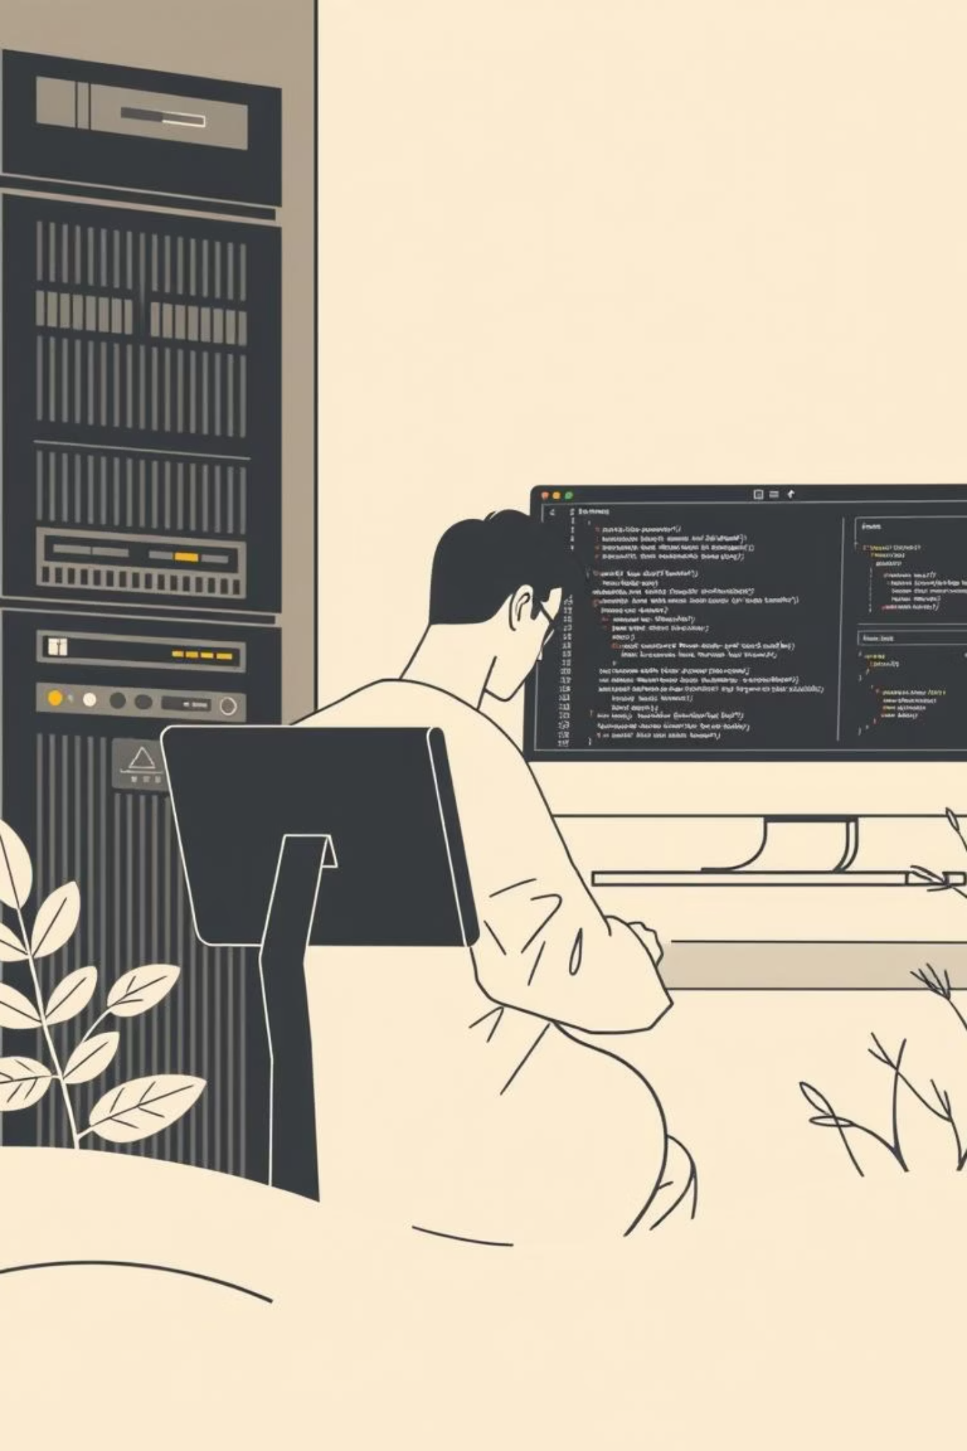
Main Tasks Before Midterm: Weeks 6–8
This phase transitions into early model integration and the foundational setup of our front-end and back-end architecture.
01
02
Model Loading & Baseline Inference
Model Evaluation & Explainability
Load pre-trained model. Conduct baseline inference on sample data videos to establish initial performance metrics.
Evaluate model accuracy and begin implementing heatmap overlays using techniques like Grad-CAM for visual explainability.
03
Early Backend & Frontend Setup
Create a FastAPI backend stub that can receive video uploads and return a placeholder deepfake score. Develop a simple front-end upload page to display this returned score.

Slide 7
Midterm Acceptance Criteria: Demonstrating Progress
Our midterm review will validate key development milestones, ensuring we are on track for successful project completion.
01
02
03
Data and Model Baseline
Explainability Overlays
Backend Stub
Fully functional data preprocessing pipeline and documented baseline results from selected model.
Evaluate model accuracy and begin implementing heatmap overlays using techniques like Grad-CAM for visual explainability.
Create a FastAPI backend stub that can receive video uploads and return a placeholder deepfake score.
04
Frontend Stub
Develop a simple front-end upload page to display this returned score.

Slide 8
Project Sponsors & Real Users
We are grateful for the support and insights from our project sponsors and real users.
Adolfo Coronado
Department Chair, PFWEmail: acoronad@pfw.edu
"Being able to download detailed reports on deepfake detection results would be incredibly valuable for our research and educational purposes."
Rohan Kumar Manna
Email: rmanna@purdue.eduRohan researches automated racing cars and is keen on utilizing deepfake detection for enhanced security in his camera-based systems.

